Slide 1
Unit ‘2’ Part 2 Group, Rings and Fields IDEA & AES
Prepared by: Abhishek Dewan
Lecturer Cryptography Trinity International College

Slide 2
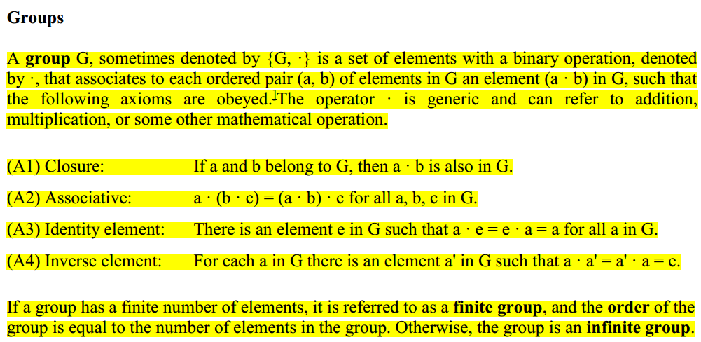
Group

Slide 3
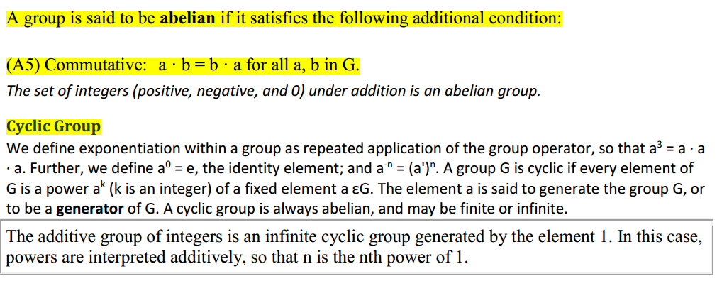

Slide 4
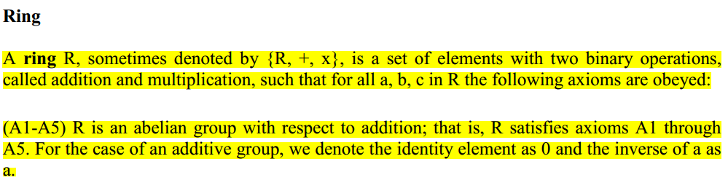
Ring

Slide 5
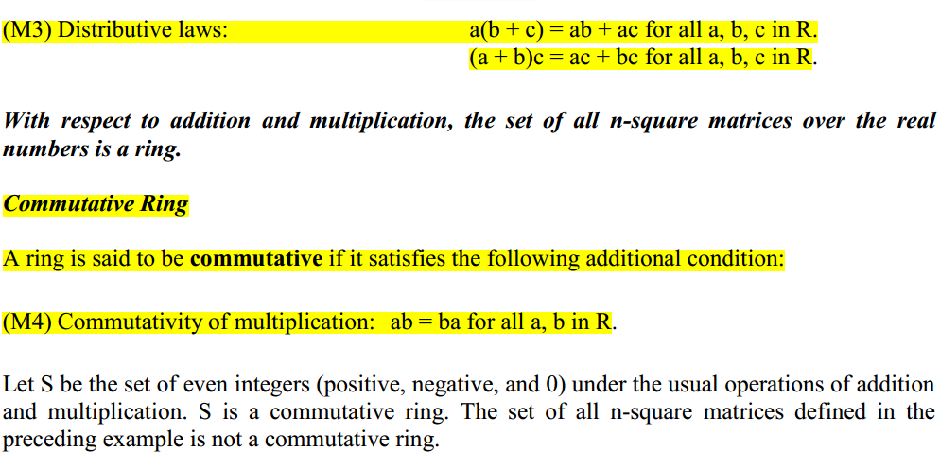

Slide 6
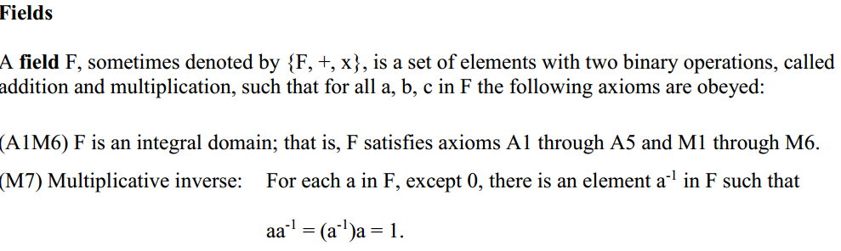
Field

Slide 7
Modular Arithmetic
Many complex cryptographic algorithms are actually based on fairly simple modular arithmetic.
In modular arithmetic, the numbers we are dealing with are just integers and the operations used are addition, subtraction, multiplication and division.

Slide 8
The only difference between modular arithmetic and the arithmetic you learned in your primary school is that in modular arithmetic all operations are performed regarding a positive integer, i.e. the modulus.

Slide 9
The division theorem tells us that for two integers a and b where b ≠ 0, there always exists unique integers q and r such that : a = qb + r
If r = 0, then
we say b divides a or a is divisible by b.
This establishes a natural congruence relation on the integers.

Slide 10
Congruent Modulo n
For a positive integer n, two integers a and b are said to be congruent modulo n (or a is congruent to b modulo n), if a and b have the same remainder when divided by n (or equivalently if a − b is divisible by n ).

Slide 11
It can be expressed as a ≡ b mod n. n is called the modulus. For example:
Two odd numbers are congruent modulo 2 because all odd numbers can be written as 2n+1;
Two even numbers are congruent modulo 2 because all even numbers can be written as 2n+0;

Slide 12
38 ≡ 23 mod 15 because 38 = 15*2 + 8 and 23 = 15 +8;
-1 ≡ 1 mod 2 because -1 = -1*2+1 and 1 = 0*2+1;

Slide 13
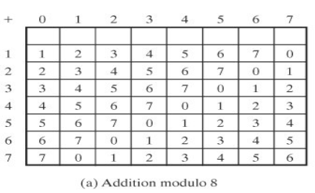

Slide 14
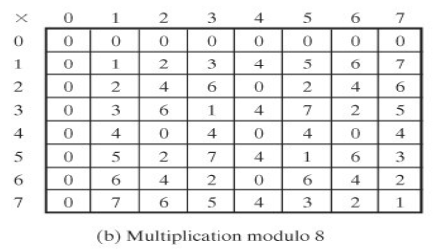

Slide 15
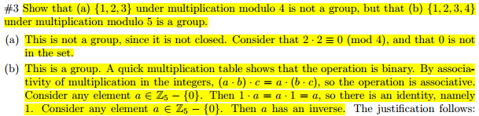
Some TU solutions

Slide 16
??
Evaluate if {1,2,3,4} under multiplication modulo 5 is a group or not.
Evaluate if {1,2,3} under multiplication modulo 4 is a group or not.

Slide 17
Set of Residues
Modulus operation creates a set, which in modular arithmetic is referred to as the set
of least residues modulo n or set of residues modulo n or just Zn.
The result of the modulo operation with modulus n is always an integer between 0 and
n-1.

Slide 18
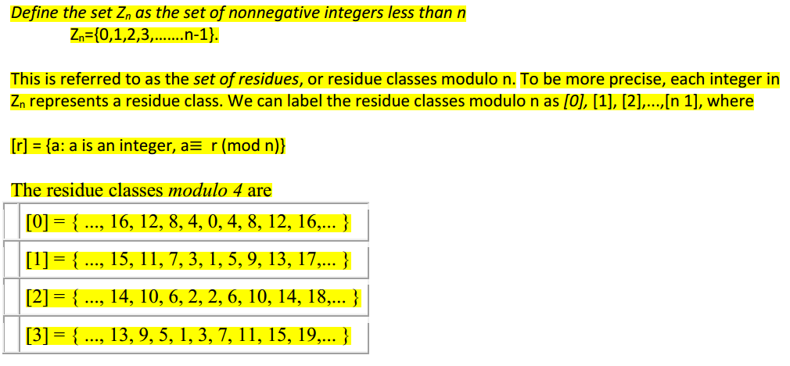
Residue Class
If n = 4,

Slide 19
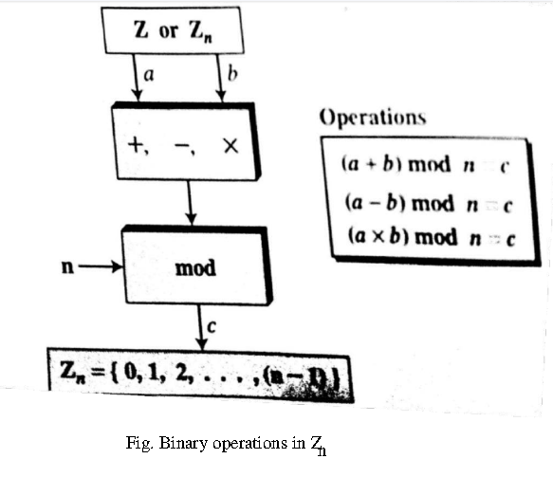
Operations in Zn

Slide 20
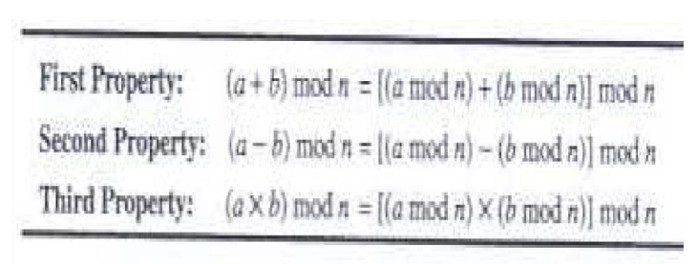
Properties

Slide 21
Inverses
Additive Inverse
In Zn, two numbers are additive inverse if a + b ≡ 0 (mod n)
Additive inverse of a can be calculated as b = n - a
Eg:- Additive inverse of 4 in Z10 = 10 - 4 = 6
Multiplicative Inverse
In Zn, two numbers are multiplicative inverse if a x b ≡ 1 (mod n)

Slide 22
???
Find Multiplicative inverse of 3 , 5 and 9 in Z11.
Find all Multiplicative inverses in Z10.
Evaluate whether Z₇ is a Ring or not.
*Note: The integer a in Z_{n} has a multiplicative inverse if and only if gcd(n,a) ≡ 1 (mod n)

Slide 23
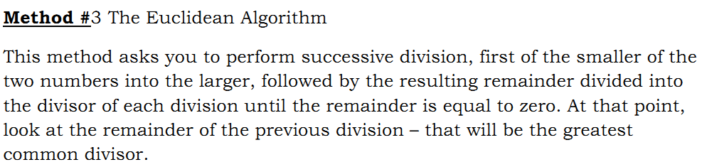
Euclidean Algorithm for GCD(a,b)

Slide 24
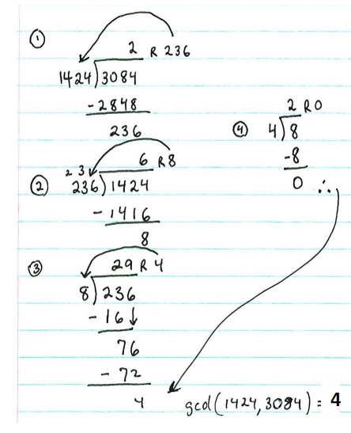
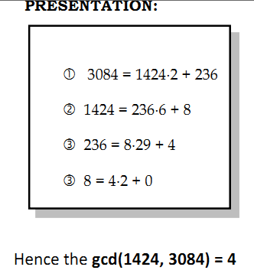

Slide 25
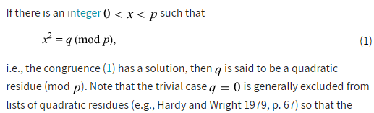
Quadratic Residue

Slide 26
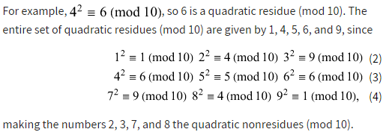
Here, Since 1², 2²,…….,9² (mod 10) all have solutions either 1,4,5,6 or 9. Therefore: 1,4,5,6 and 9 are quadratic residues (mod 10)

Slide 27
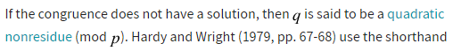
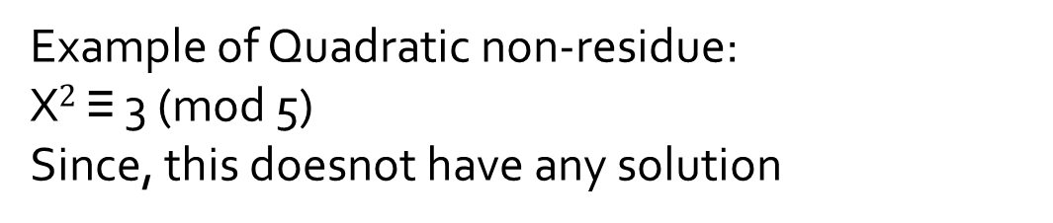
Example of Quadratic non-residue:
X$2$ ≡ 3 (mod 5)
Since, this doesnot have any solution

Slide 28
???
Evaluate quadratic residues of (mod 7)
Evaluate quadratic residues of Z₈

Slide 29
Relative Prime Numbers
In number theory, two integers a and b are said to be relatively prime, mutually prime, or coprime (also spelled co-prime) if the only positive integer that divides both of them is 1.
That is, the only common positive factor of the two numbers is 1.
This is equivalent to their greatest common divisor being 1.
Euclidean Algorithm for calculating GCD can be used to test whether the given numbers are relatively prime or not.

Slide 30
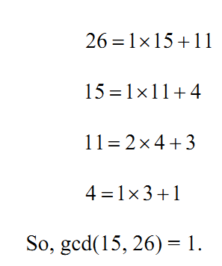
Finding Multiplicative Inverses Modulo n using Extended Euclidean Algorithm
Any positive integer that is less than n and relatively prime to n has a multiplicative inverse modulo n.
This is a consequence of the Euclidean algorithm.

Slide 31
What is the multiplicative inverse of 7 in Z₁₆₀
???

Slide 32
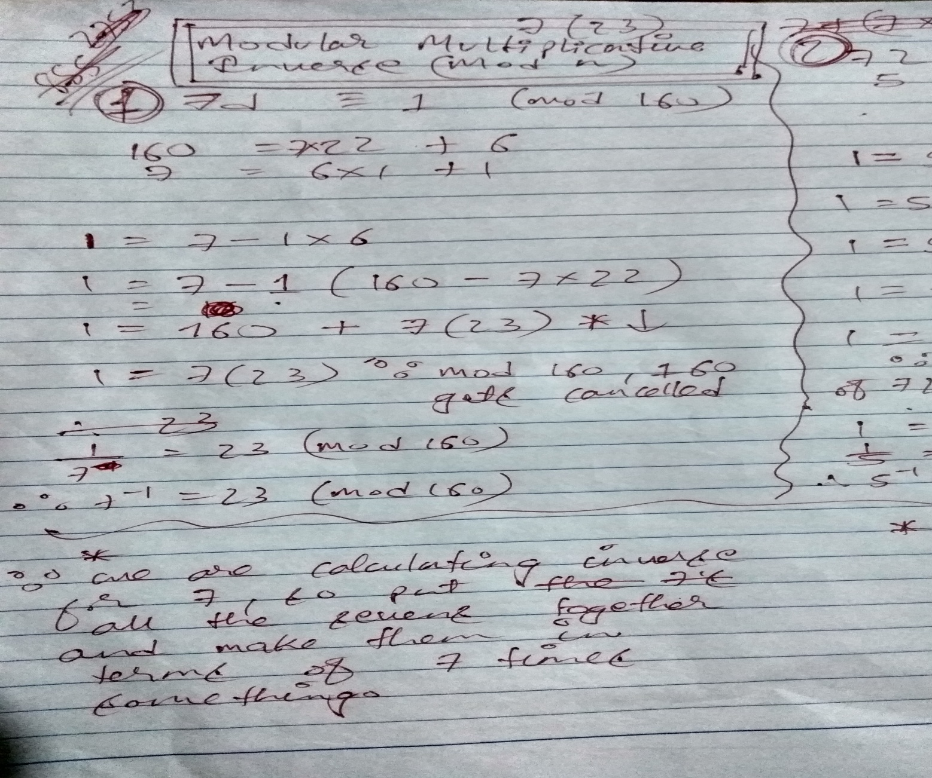

Slide 33
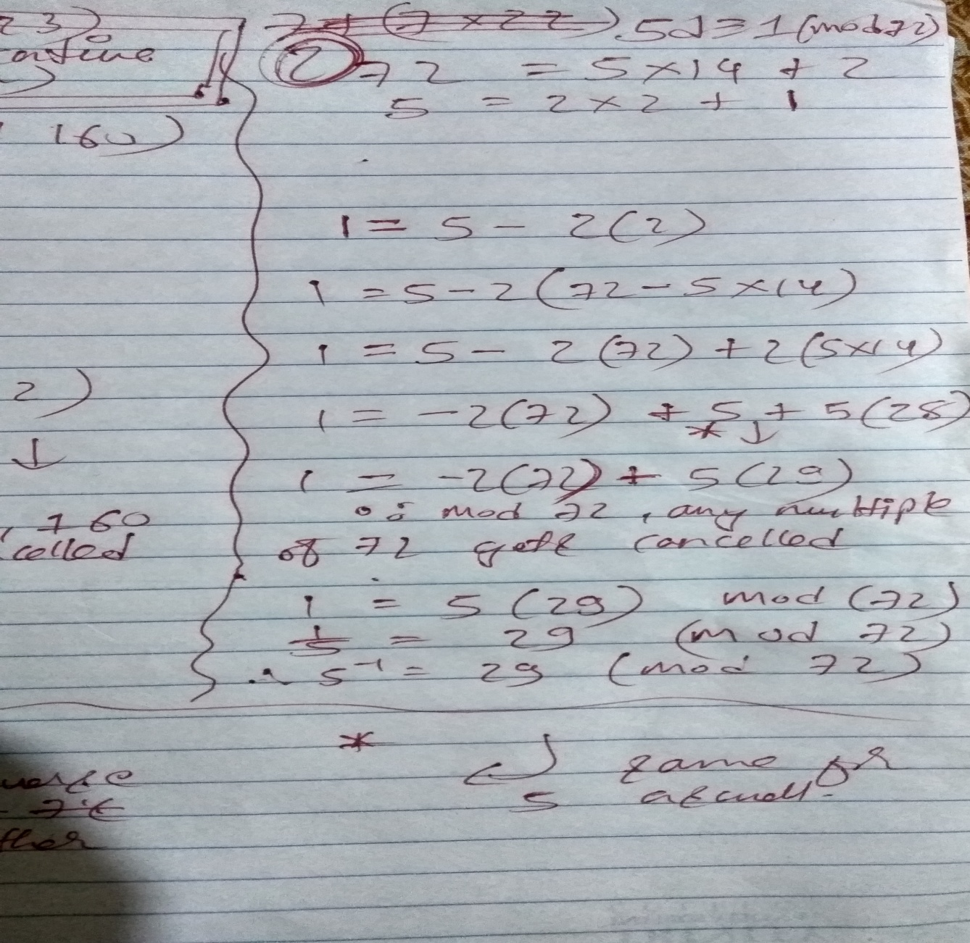

Slide 34
???
Calculate the multiplicative inverse of 17 with respect to (mod 3120)
Calculate the multiplicative inverse of 17 (mod 43)

Slide 35
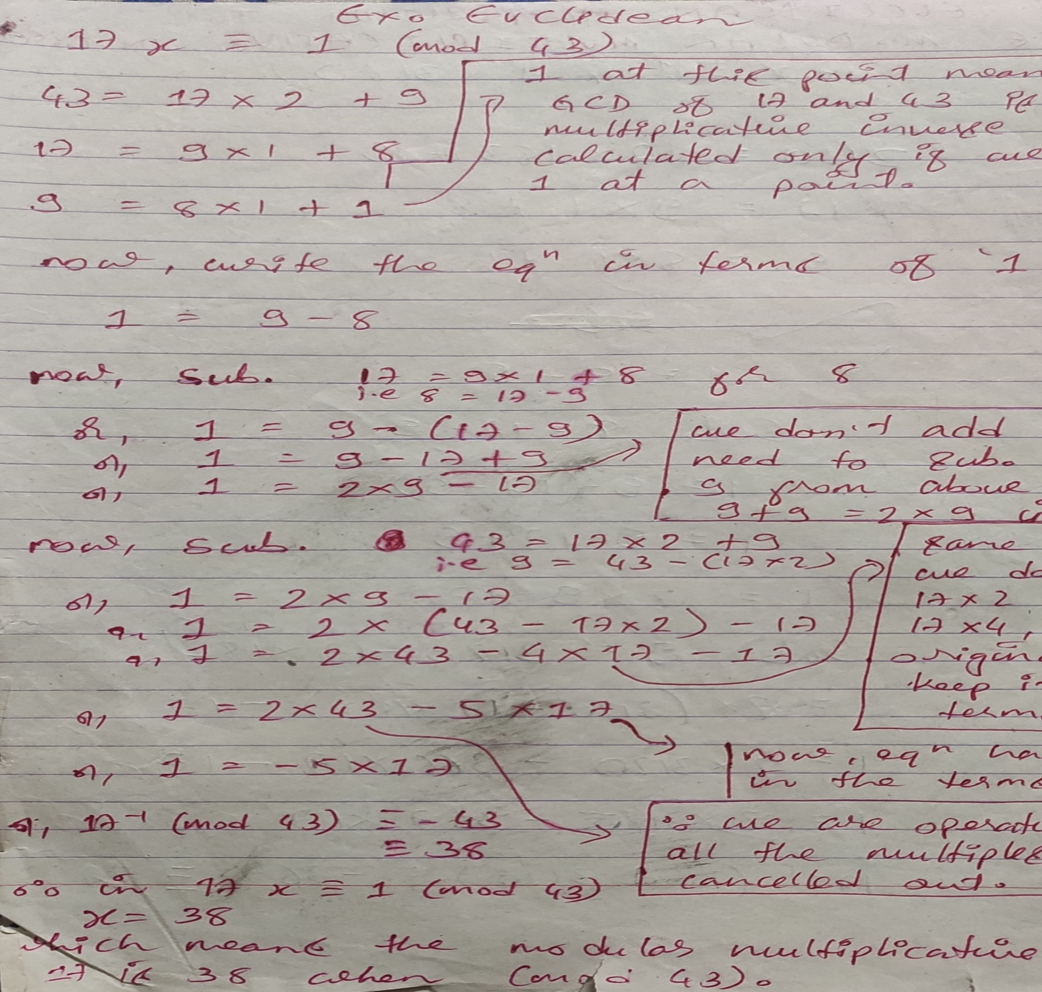

Slide 36
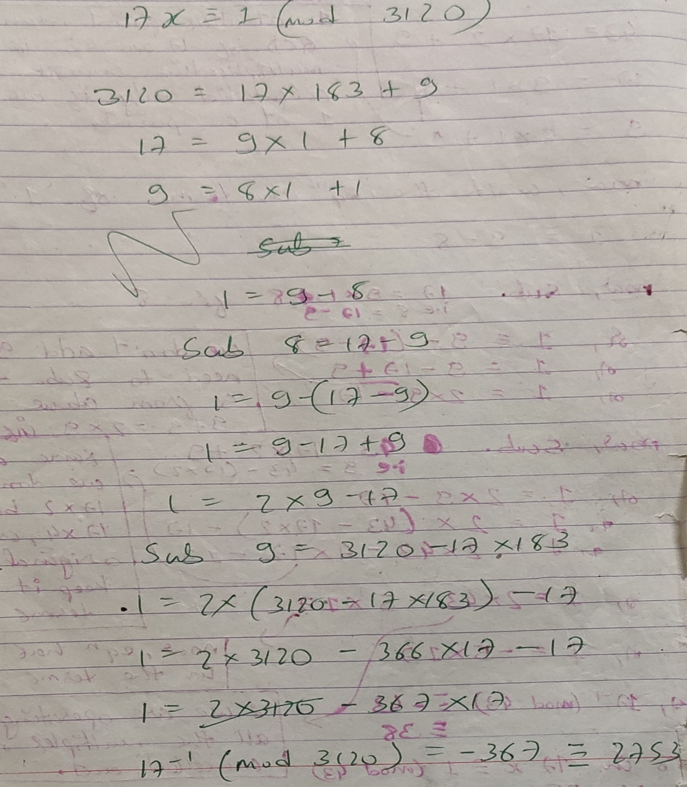

Slide 37
Galois Field
If p is a prime, then the integers mod p form a field called Galois field denoted by GF(p^{n}).
Galois field has p^{n} elements.
For example, the integers mod 7 are the numbers 0 through 6 with addition and multiplication defined mod 7.
All finite fields have p^{n} elements where p is prime and n is an integer at least 1.

Slide 38
The field with p^{n} elements is sometimes called the Galois field with that many elements, written GF(p^{n}).
The Galois fields of order GF(p) are simply the integers mod p.

Slide 39
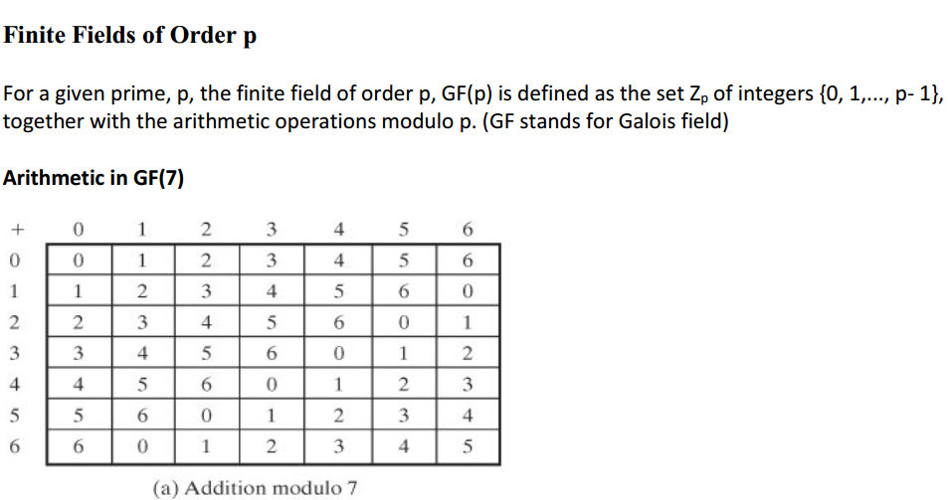

Slide 40
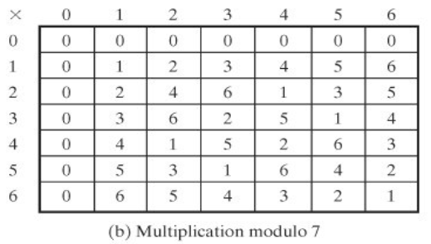

Slide 41
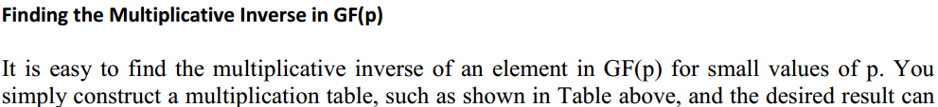

Slide 42
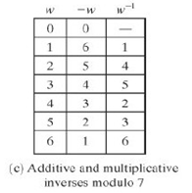
Additive and multiplicative inverse of small number over GF(7):

Slide 43
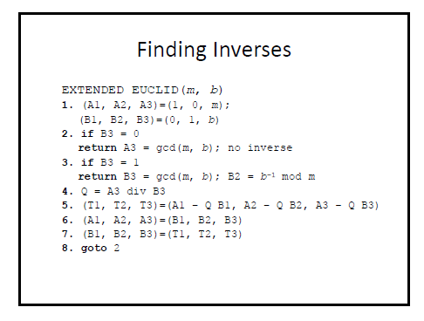
Algorithm for multiplicative inverse of large number over GF:

Slide 44
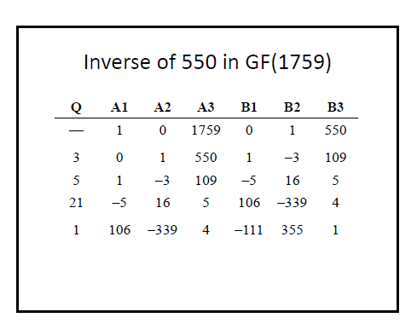
Example:

Slide 45
???
Evaluate multiplicative of 350 in GF(1759).

Slide 46
Polynomial Operations in GF(p)
The elements of GF(p^{n}) are polynomials of degree n-1 with coefficients coming from GF(p).
If the coefficients are taken from a field F, then we say it is a polynomial over F.
you can add and multiply polynomials just like you have always done the coefficients need to be reduced modulo p.

Slide 47
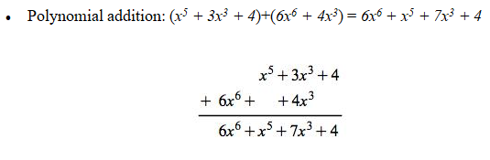
Normal Polynomial Operations:

Slide 48
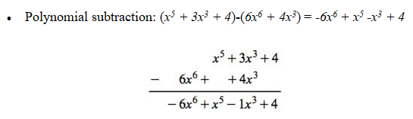

Slide 49
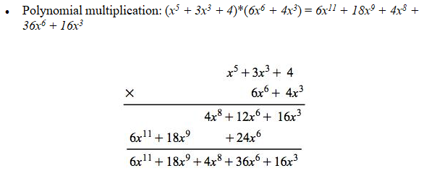

Slide 50
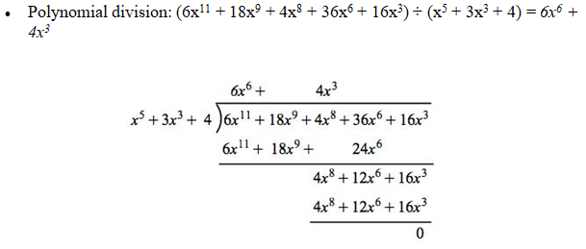

Slide 51
For example, compare the above results with polynomials over GF(11):

Slide 52
(x⁵ + 3x³ + 4)+(6x⁶ + 4x³) = 6x⁶ + x⁵ + 7x³ + 4
(x⁵ + 3x³ + 4)-(6x⁶ + 4x³) = 5x⁶ + x⁵ +10x³ + 4
(x⁵ + 3x³ + 4)*(6x⁶ + 4x³) = 6x¹¹ + 7x⁹ + 4x⁸ + 3x⁶ + 5x³
(3x⁶ + 7x⁴ + 4x³ + 5) ÷ (x⁴ + 3x³ + 4) = 3x² + 3x + 3 with remainder x³ + 10x² + 4x +1

Slide 53
For n > 1, the elements of GF(p^{n}) are polynomials of degree n-1 with coefficients coming from GF(p^{n}).

Slide 54
GF(2^{n})
Finite fields of order 2^{n} are called binary fields or characteristic-two finite fields.
The elements of GF(2^{n}) are binary polynomials, i.e. polynomials whose coefficients are either 0 or 1.

Slide 55
For example, GF(2³) contains 8 element {0, 1, x, x+1, x², x²+1, x²+x, x²+x+1}.
x+1 is actually 0x²+1x+1, so it can be represented as a bit string 011.
Similarly, x²+x = 1x²+1x+0, so it can be represented as 110.

Slide 56
In modulo 2 arithmetics, 1+1 ≡ 0 mod 2, 1+0 ≡ 1 mod 2 and 0+0 ≡ 0 mod 2, which coincide with bit-XOR, i.e. 1⊕1=0, 1⊕0=1 0⊕0=0.
Therefore for binary polynomials, addition is simply bit-by-bit XOR.
Also, in modulo 2 arithmetics, -1 ≡ 1 mod 2, so the result of subtraction of elements is the same as addition.

Slide 57
Following is the example of GF(2³) Addition Table :

Slide 58
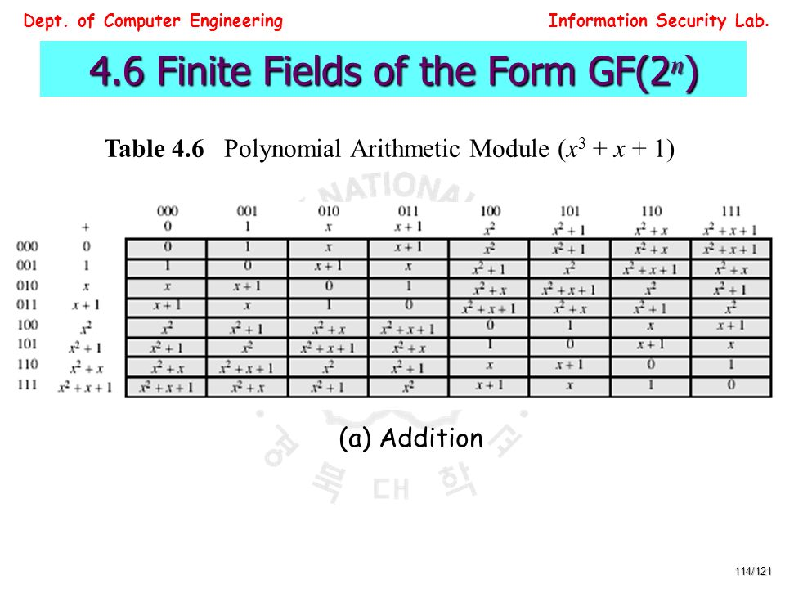

Slide 59
multiplication is a little different.
In GF(2^{n}), when the degree of the result is more than n-1, it needs to be reduced modulo a irreducible/primitive polynomial.

Slide 60
Irreducible Polynomial
If a polynomial is divisible only by itself and constants, then we call this polynomial an irreducible polynomial.

Slide 61
Addition in polynomials is as usual, but
In multiplication, You pick an irreducible polynomial g(x) of degree n and define multiplication in GF(p^{n}) to be the ordinary polynomial product,

Slide 62
But, if the product has polynomial with degree greater than n-1 ,you take the remainder after dividing by g(x).

Slide 63
Let’s look at GF(2³), the field with 8 elements, i.e. 3-bit numbers.
We choose g(x) = x³ + x + 1 as our irreducible polynomial.

Slide 64
The number 3 (11₂) corresponds to the polynomial x + 1.
The number 5 (101₂) corresponds to x² + 1.
The sum of 3 and 5 in this field corresponds to x² + x, which correspond to 6.

Slide 65
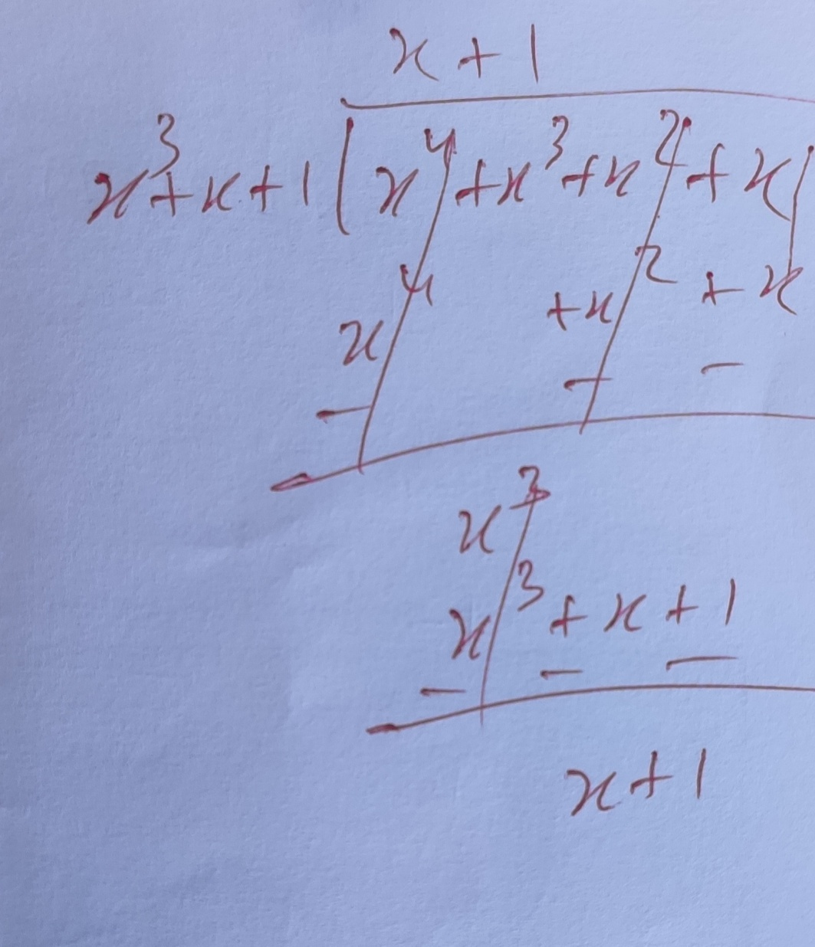
To compute the product of 5 and 6 in this field, we multiply (x² + 1)(x² + x).
Since degree is > than n-1, we divide the product by x³ + x + 1, working mod 2, we get a remainder of x + 1, which corresponds to 3.
So in this field, 5 times 6 equals 3.

Slide 66
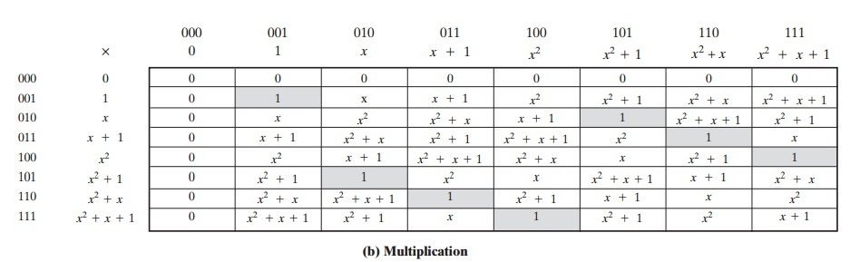

Slide 67
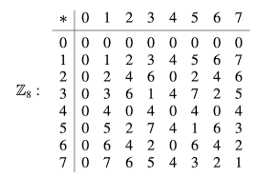
Was Z₈ a Field before???

Slide 68
Example 1. For a=x²+x+1 (7–111₂) and b=x+1 (3–011₂) with a primitive of x⁴+x+1 over (GF(2⁴)):
Add=(x²+x+1)+(x+1)=x² (4–100₂)
Mult=(x²+x+1)×(x+1)=x³+x²+x²+x+x+1=x³+1 (9–1001₂)

Slide 69
As we are using modulo 2 addition, then x+x=0 and x²+x²=0.
As the power of the multiplication is not greater than x⁴ and above, there is no need to divide by the irreducible polynomial.

Slide 70
Example 2. For a=x³ (8–1000₂) and b=x²+1 (5–101₂) with a primitive of x⁴+x+1 over (GF(2⁴)).
Add=(x³)+(x²+1)=x³+x²+1 (13–1101₂)
Mult=(x³)×(x²+1)=x⁵+x³ (14–1110₂)

Slide 71
Now we divide x⁵+x³ by the primitive (x⁴+x+1) and get the remainder:
x x⁴ + x+1 | x⁵+x³ x⁵ +x²+x ------------- x³+x²+x
Thus the result of the multiplication is the remainder x³+x²+x.

Slide 72
Example 3. For a=x³+1 (9–1001₂) and b=x²+1 (5–101₂) with a primitive of x⁴+x+1 over (GF(2⁴)).
Add=(x³+1)+(x²+1)=x³+x²
Mult=(x³+1)×(x²+1)=x⁵+x³+x²+1

Slide 73
Now we divide x⁵+x³+x²+1 by the irreducible (x⁴+x+1) and get the remainder:
__x____________ x⁴ + x+1 | x⁵+ x³+x² +1 x⁵ +x²+x ----------------------- x³+ x +1
Thus the result of the multiplication is x³+x+1 (11- 1011₂).

Slide 74
For example, the finite field GF(3²) can be constructed as the set of polynomials whose degrees are at most 1, with addition and multiplication done modulo the irreducible polynomial x²+1 (you can also choose another modulus, as long as it is irreducible and has degree 2).

Slide 75
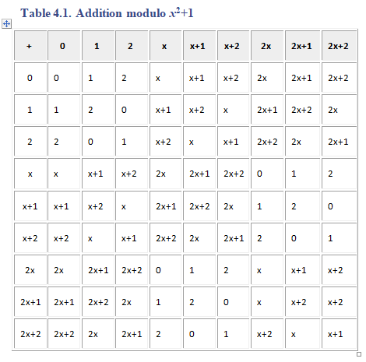

Slide 76
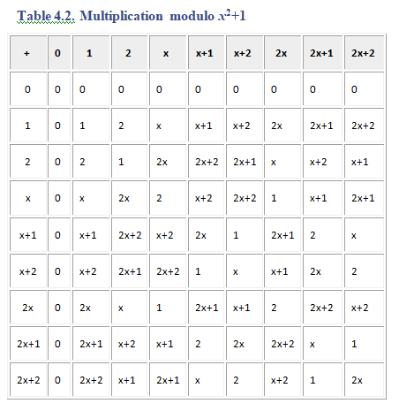

Slide 77
Example: Division over GF
Let’s divide 5x²+4x+6 by 2x+1 over GF(7):
____6x+6____________
2x+1 | 5x²+4x+6
5x²+6x ----------------------- - 2x+6
=5x+6 5x+6 -----------------------
0

Slide 78
You can trivially multiply 5x²+4x+6 by 2x+1 over GF(7) to check the result.

Slide 79
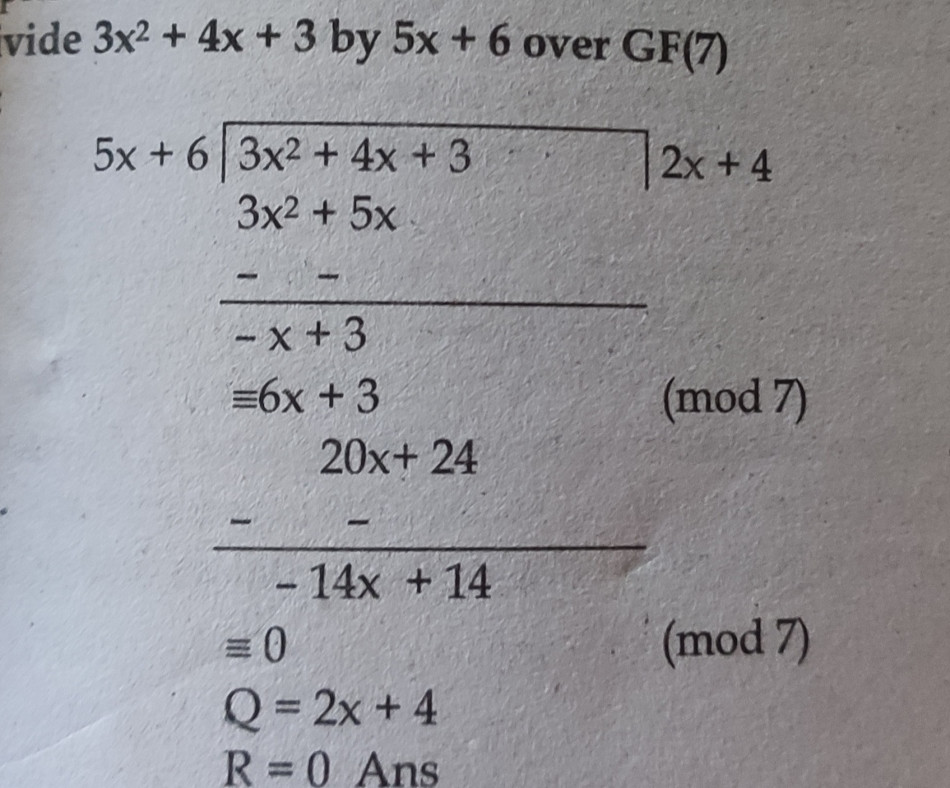
???
Divide 3x²+4x+3 by 5x+6 over GF(7):

Slide 80
7.13 HOMEWORK PROBLEMS
1. This question is a litmus test of whether you understand the concepts presented in this lecture at a deep level: As mentioned in Section 7.2, there exist two different irreducible polynomials of degree 3 over GF (2):
_{x}3
+ x + 1
and
_{x}3
+ x² + 1
Obviously, the finite field GF (2³) can be constructed with either of these two irreducible polynomials. Regardless of which polynomial we use, we end up with the same set of bit patterns:
{000, 001, 010, 011, 100, 101, 110, 111}. The MI
(multiplicative inverse) of 010 is 101 when you base GF (2³) on the irreducible polynomial x³ + x + 1The question you are
being asked is whether the MI of 010 will be different when
GF (2³) is based on x³ + x² + 1?
2. When the set of all integers is divided by a prime, we obtain a set of remainders whose elements obey a certain special

Slide 81
property with regard to the modulo multiplication operator over the set. What is that property?
As computer engineers, our world of work is steeped in bits and bytes. Yet we seem to be obsessing about polynomials. Pourquoi?
When the set of all polynomials over GF (p) for a prime p is divided by an irreducible polynomial, we obtain a set of remainders with some very special properties. What is so special about this set? How is such a set denoted?
How do we get a finite field of the form GF (2^{n}) ?
If GF (p) gives us a finite field (with p elements), why is that not good enough for us? Why do we need finite fields of the form GF (2^{n})?
How will you prove that GF (2³) is at least an integral domain? How will you prove it is a finite field?

Slide 82
9. With polynomial coefficients drawn from GF (2), let’s use the irreducible polynomial x³ + x + 1 to construct the finite field GF (2³). Now calculate
(x² + x + 1) + (x² + 1) | = | ?
(x² + x + 1) − (x² + 1) | = | ?
(x² + x + 1) × (x² + 1) | = | ?
(x² + x + 1) / (x² + 1) | = | ?
10. Given the following two 3-bit binary code words from GF (2³) with the modulus polynomial x³ + x + 1:
 | B₁ | = | 1 1 1
 | B₂ | = | 1 0 1
Now calculate:
B₁ + B₂ |  |  | = | ?
B₁ − B₂ |  |  | = | ?
B₁ × B₂ |  |  | = | ?

Slide 83
The IDEA Algorithm
IDEA is a block cipher which uses a 128-bit length key to encrypt successive 64-bit blocks of plaintext.
Avoids the use of any lookup tables or S-boxes.
IDEA uses 52 subkeys, each 16 bits long. Two are used during each round proper, and four are used before every round and after the last round.

Slide 84
It has eight rounds.
The plaintext block in IDEA is divided into four quarters, each 16 bits long.
Three operations: addition, XOR, and multiplication are used in IDEA to combine two 16 bit values to produce a 16 bit result.

Slide 85
Key Generation
First, the 128-bit key is partitioned into eight 16-bit sub-blocks which are then directly used as the first eight key sub-blocks.
The 128-bit key is then cyclically shifted to the left by 25 positions, after which the resulting 128-bit block is again partitioned into eight 16-bit sub-blocks to be directly used as the next eight key sub-blocks.

Slide 86
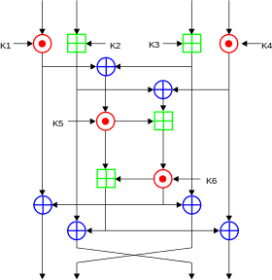
Encryption

Slide 87
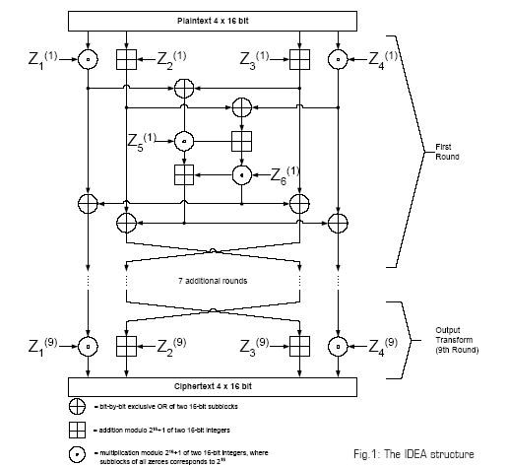

Slide 88
Let the four quarters of the plaintext be called A, B, C, and D, and the 52 subkeys called K(1) through K(52).
Before round 1, or as the first part of it, the following is done:
Multiply A by K(1). Add K(2) to B. Add K(3) to C. Multiply D by K(4).
addition modulo 2¹⁶ and multiplication modulo 2¹⁶ + 1 are used.

Slide 89
Calculate A xor C (call it E) and B xor D (call it F).
Multiply E by K(5). Add the new value of E to F.
Multiply the new value of F by K(6). Add the result, which is also the new value of F, to E.
Change both A and C by XORing the current value of F with each of them; change both B and D by XORing the current value of E with each of them.
Swap B and C.

Slide 90
Repeat all of this eight times, or seven more times, using K(7) through K(12) the second time, up to K(43) through K(48) the eighth time. Note that the swap of B and C is not performed after round 8.
Then multiply A by K(49). Add K(50) to B. Add K(51) to C. Multiply D by K(52).

Slide 91
Decryption
The computational process used for decryption of the ciphertext is essentially the same as that used for encryption of the plaintext.
each of the 52 16-bit key sub-blocks used for decryption is the inverse of the key sub-block used during encryption.
the key sub-blocks must be used in the reverse order during decryption in order to reverse the encryption process

Slide 92
Advanced Encryption Standard (AES)
Like DES, AES is a symmetric block cipher. This means that it uses the same key for both encryption and decryption.
allows for a variety of block and key sizes.
The block and key can in fact be chosen independently from 128, 160, 192, 224, 256 bits and need not be the same.

Slide 93
However, the AES standard states that the algorithm can only accept a block size of 128 bits and a choice of three keys - 128, 192, 256 bits.
Depending on which version is used, the name of the standard is modified to AES-128, AES-192 or AES256 respectively. As well as these differences AES differs from DES in that it is not a feistel structure.

Slide 94
in a feistel structure, half of the data block is used to modify the other half of the data block and then the halves are swapped.
In this case the entire data block is processed in parallel during each round using substitutions and permutations.

Slide 95
A number of AES parameters depend on the key length.
For example, if the key size used is 128 then the number of rounds is 10 whereas it is 12 and 14 for 192 and 256 bits respectively.
At present the most common key size likely to be used is the 128 bit key.

Slide 96
Have the following characteristics:
• Resistance against all known attacks.
• Speed and code compactness on a wide range of platforms.
• Design Simplicity.

Slide 97
Workings of a Round
The algorithm begins with an Add round key stage followed by 9 rounds of four stages and a tenth round of three stages.
This applies for both encryption and decryption with the exception that each stage of a round the decryption algorithm is the inverse of it’s counterpart in the encryption algorithm

Slide 98
The four stages are as follows:
1. Substitute bytes
2. Shift rows
3. Mix Columns
4. Add Round Key

Slide 99
The tenth round simply leaves out the Mix Columns stage. The first nine rounds of the decryption algorithm consist of the following:
1. Inverse Shift rows
2. Inverse Substitute bytes
3. Inverse Add Round Key
4. Inverse Mix Columns

Slide 100
Again, the tenth round simply leaves out the Inverse Mix Columns stage. Each of these stages will now be considered in more detail.

Slide 101
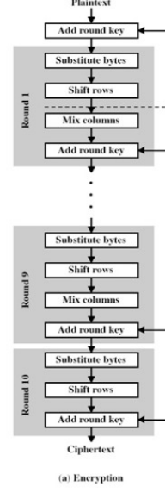

Slide 102
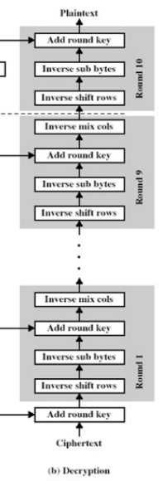

Slide 103
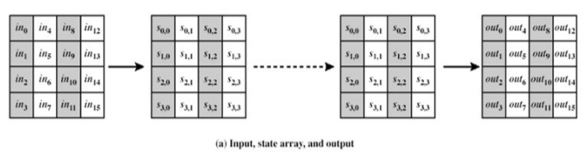
The matrix that gets operated upon throughout the encryption is known as state.

Slide 104
Substitute Bytes
This stage (known as SubBytes) is simply a table lookup using a 16×16 matrix of byte values called an s-box.
This matrix consists of all the possible combinations of an 8 bit sequence (2⁸ = 16 × 16 = 256).

Slide 105
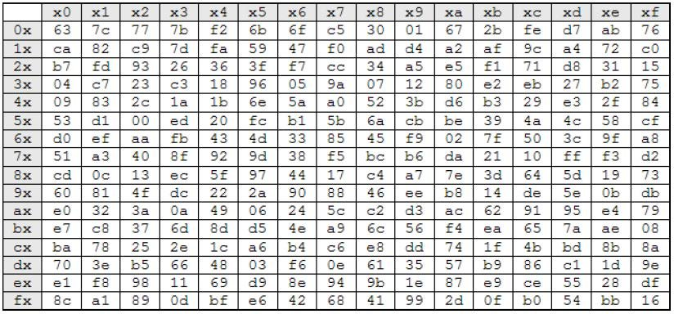

Slide 106
Each byte is mapped into a new byte in the following way: the leftmost nibble of the byte is used to specify a particular row of the s-box and the rightmost nibble specifies a column.

Slide 107
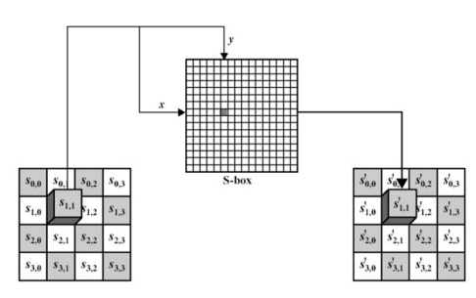

Slide 108
The Inverse substitute byte transformation (known as InvSubBytes) makes use of an inverse s-box during decryption.

Slide 109
Shift Row Transformation
This stage (known as ShiftRows)
This is a simple permutation an nothing more.
It works as follow:

Slide 110
The first row of state is not altered.
• The second row is shifted 1 bytes to the left in a circular manner.
• The third row is shifted 2 bytes to the left in a circular manner.
The fourth row is shifted 3 bytes to the left in a circular manner

Slide 111
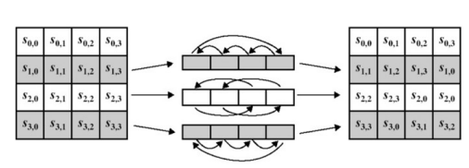

Slide 112
During decryption, The Inverse Shift Rows transformation (known as InvShiftRows) performs these circular shifts in the opposite direction for each of the last three rows (the first row was unaltered to begin with).

Slide 113
Mix Column Transformation
This stage (known as MixColumn) is basically a substitution but it makes use of arithmetic of GF(2⁸)
The transformation can be determined by the following matrix multiplication on state.

Slide 114
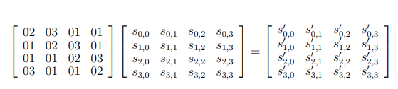

Slide 115
Each element of the product matrix is the sum of products of elements of one row and one column.
In this case the individual additions and multiplications are performed in GF(2⁸ ).

Slide 116
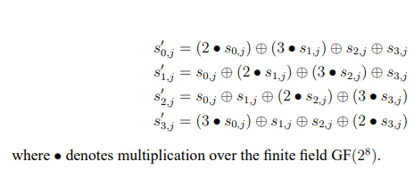
The MixColumns transformation of a single column j (0 ≤ j ≤ 3) of state can be expressed as:

Slide 117


Slide 118


Slide 119


Slide 120


Slide 121


Slide 122


Slide 123
Add Round Key Transformation
In this stage (known as AddRoundKey) the 128 bits of state are bitwise XORed with the 128 bits of the round key.
The operation is viewed as a columnwise operation between the 4 bytes of a state column and one word of the round key.

Slide 124
Diffusion and Confusion
Diffusion means that if we change a character of the plaintext, then several characters of the ciphertext should change, and similarly, if we change a character of the ciphertext, then several characters of the plaintext should change.
Hill cipher has this property. This means that frequency statistics of letters, [digraphs], etc. in the plaintext are diffused
over several characters in the ciphertext.

Slide 125
Confusion means that the key does not relate in a simple way to the ciphertext.
In particular, each character of the ciphertext should depend on several parts of the key.

Slide 126
Modes of Block Cipher Encryptions
Electronic Codebook (ECB)
The simplest of the encryption modes is the Electronic Codebook (ECB) mode.
The message is divided into blocks, and each block is encrypted separately.

Slide 127


Slide 128


Slide 129
The disadvantage of this method is a lack of diffusion.
Because ECB encrypts identical plaintext blocks into identical ciphertext blocks, it does not hide data patterns well.

Slide 130
A striking example of the degree to which ECB can leave plaintext data patterns in the ciphertext can be seen when ECB mode is used to encrypt a bitmap image which uses large areas of uniform color.
While the color of each individual pixel is encrypted, the overall image may still be discerned as the pattern of identically colored pixels in the original remains in the encrypted version.

Slide 131



Slide 132

Modes other than ECB result in pseudo-randomness:

Slide 133
Cipher Block Chaining (CBC)
In CBC mode, each block of plaintext is XORed with the previous ciphertext block before being encrypted.
This way, each ciphertext block depends on all plaintext blocks processed up to that point.
To make each message unique, an initialization vector must be used in the first block.

Slide 134
Initialization vector (IV)
An initialization vector (IV) or starting variable (SV) is a block of bits that is used by several modes to randomize the encryption and hence to produce distinct cipher texts even if the same plaintext is encrypted multiple times.

Slide 135


Slide 136


Slide 137
If the first block has index 1, the mathematical formula for CBC encryption is
C_{i} = E_{k} (P_{i} + C_{i-1})
C₀=IV
while the mathematical formula for CBC decryption is
P_{i} = D_{k} (C_{i}) + C_{i-1}
C₀=IV

Slide 138
CBC has been the most commonly used mode of operation.
Its main drawbacks are that encryption is sequential and that the message must be padded to a multiple of the cipher block size.

Slide 139
Cipher Feedback (CFB)
The Cipher Feedback (CFB) mode, a close relative of CBC.
Operation is very similar; in particular, CFB decryption is almost identical to CBC encryption performed in reverse:

Slide 140

C_{i} = E_{k} (C_{i-1}) + P_{i} C₀=IV

Slide 141

P_{i} = E_{k} (C_{i-1}) + C_{i}

Slide 142
Output Feedback (OFB)
The Output Feedback (OFB) generates keystream blocks, which are then XORed with the plaintext blocks to get the ciphertext.

Slide 143

C_{j}=P_{j} + O_{j}
P_{j}=C_{j}+O_{j}

Slide 144


Slide 145
Counter (CTR)
Like OFB, Counter mode generates the next keystream block by encrypting successive values of a "counter".
The counter can be any function which produces a sequence which is guaranteed not to repeat for a long time, although an actual increment-by-one counter is the simplest and most popular.

Slide 146


Slide 147


Slide 148
End of Unit ‘2’

